Slide 1

Bluestock Mutual Fund Analytics Capstone
Submitted By:
Srinivas Aditya A
M.Tech (Research Assistant)
Department of Artificial Intelligence
Indian Institute of Technology Hyderabad

Slide 2
PROBLEM STATEMENT & OBJECTIVES
Problem Statement : The mutual fund industry generates large volumes of data related to fund performance, investor transactions, portfolio holdings, and market benchmarks. Extracting meaningful insights from this data requires structured analytics and visualization frameworks.
Project Objectives
Build an automated ETL pipeline
Design an analytical database
Perform exploratory data analysis
Evaluate fund performance using financial metrics
Develop an interactive Power BI dashboard
Generate actionable business insights
Workflow :
Raw Data
ETL
Analytics
Dashboard
Insights

Slide 3
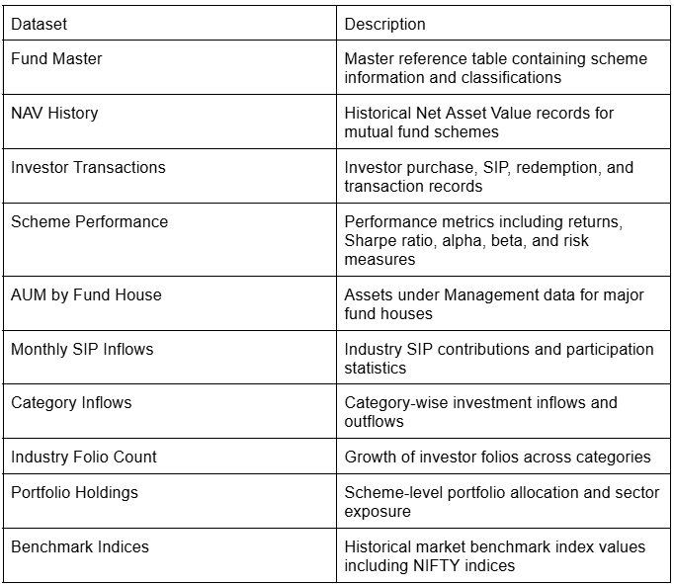
DATA SOURCES
Datasets Used (Analysis Period : 2022-2026)
Fund Master
NAV History
Investor Transactions
Scheme Performance
AUM by Fund House
Monthly SIP Inflows
Category Inflows
Industry Folio Count
Portfolio Holdings
Benchmark Indices
Key Dimensions:
Fund Performance
Investor Behaviour
Risk Analytics
Market Trends
Dataset Summary :

Slide 4
System Architecture & ETL Pipeline
Pipeline Workflow:
Automated ETL pipeline developed using Python
SQLite used as analytical database
Power BI used for dashboard visualization
Raw Csv Datasets
Data Validation
Data Cleaning
SQLite Database
EDA and Analytics
PowerBI Dashboard
Business Insights

Slide 5
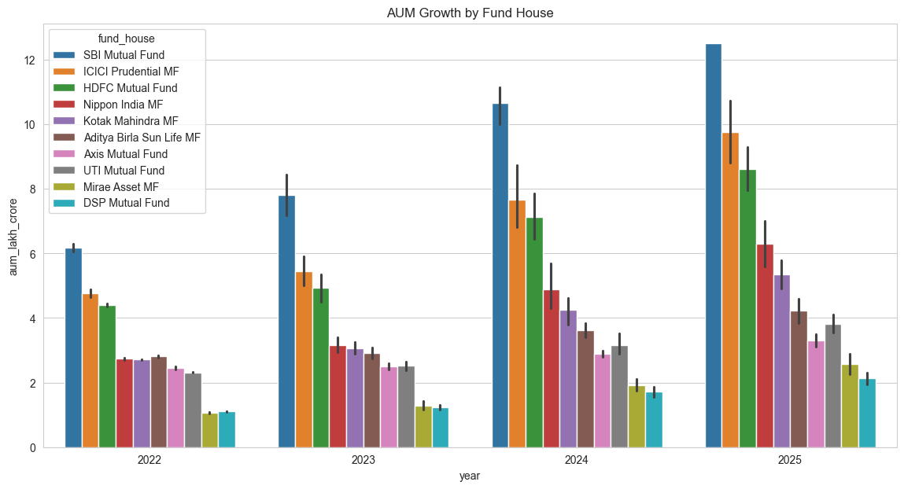
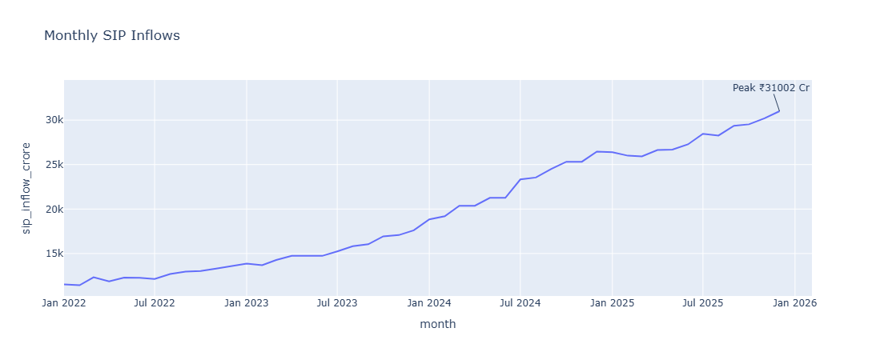
EDA Highlights – Industry Growth
Key Findings
Industry AUM increased steadily from 2022–2025
SBI Mutual Fund maintained highest AUM
SIP inflows reached record highs in 2025
Retail participation continued to increase

Slide 6
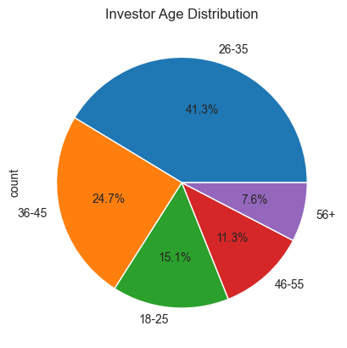
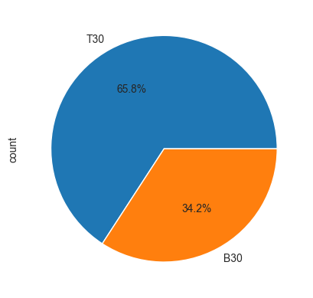
EDA Highlights – Investor Behaviour
Key Findings
Investors aged 26–45 dominated participation
Maharashtra, Karnataka and Telangana led investments
T30 cities contributed majority of investments
B30 participation showed gradual growth

Slide 7
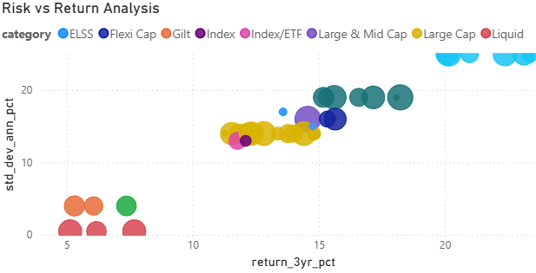
Mutual Fund Performance Evaluation
Metrics Computed
CAGR
Sharpe Ratio
Sortino Ratio
Alpha
Beta
Maximum Drawdown
Key Observation
Funds with superior risk-adjusted returns consistently ranked higher than peers.

Slide 8
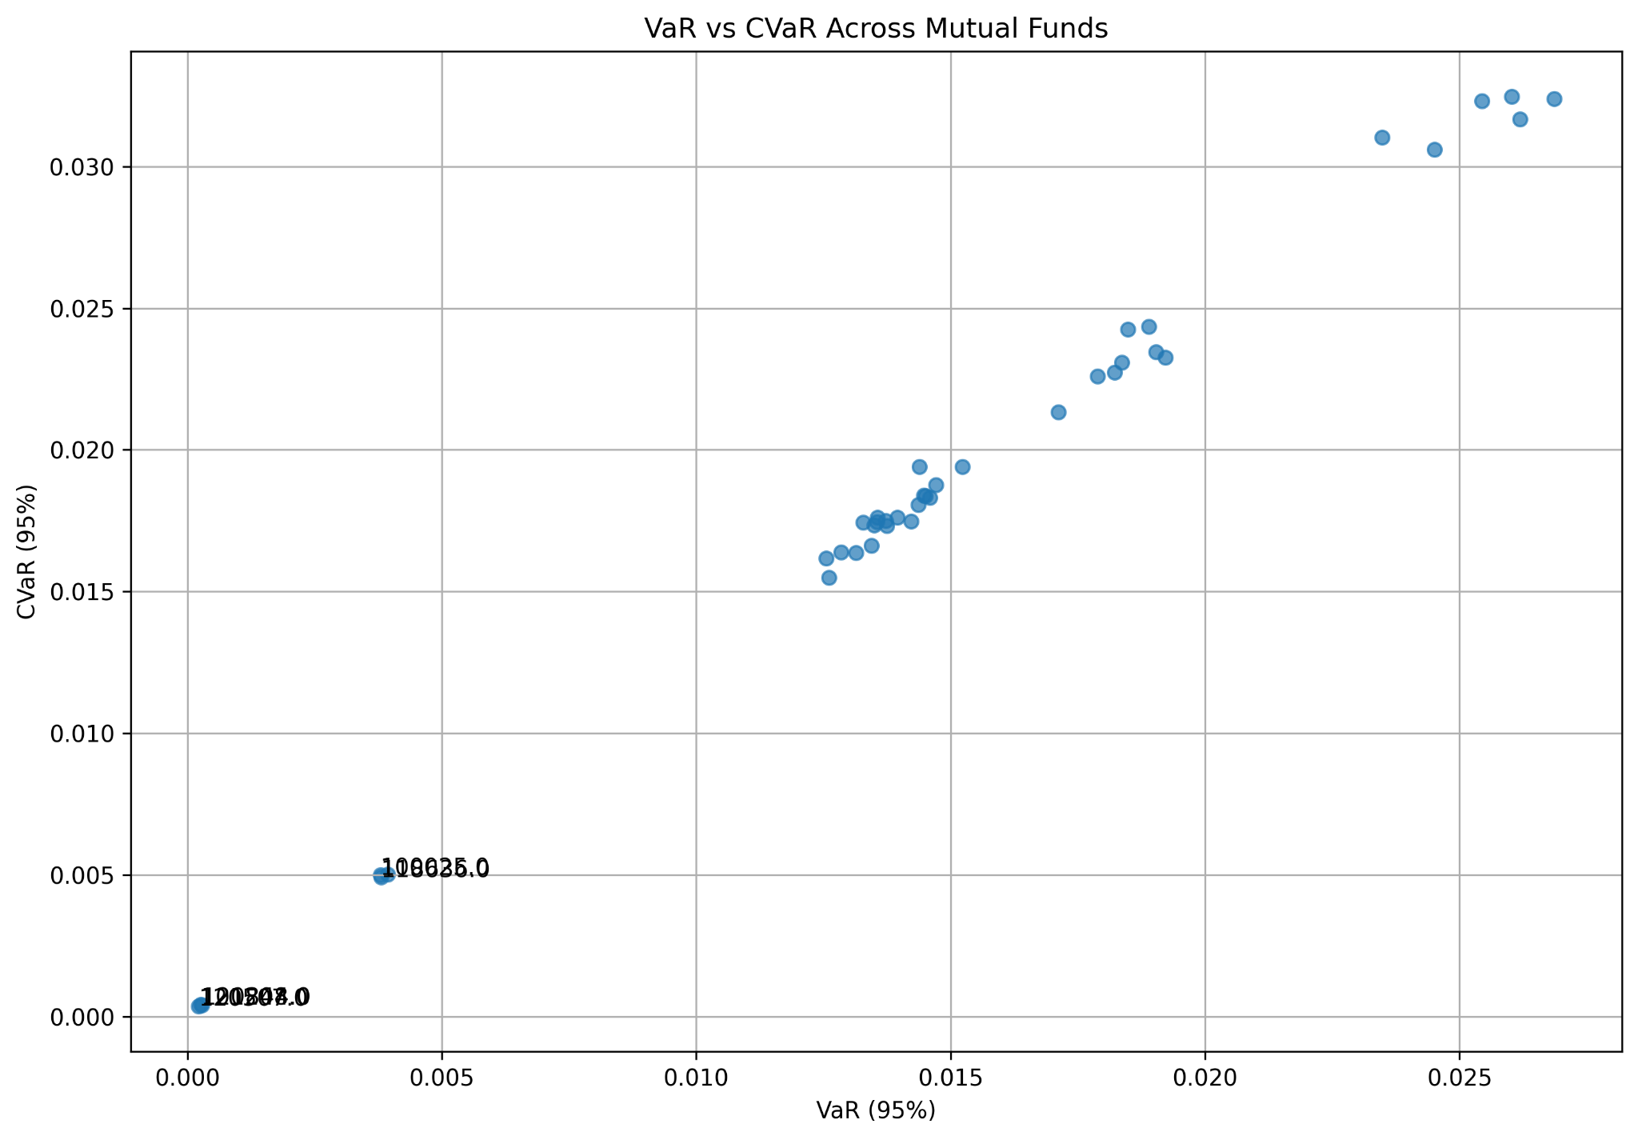
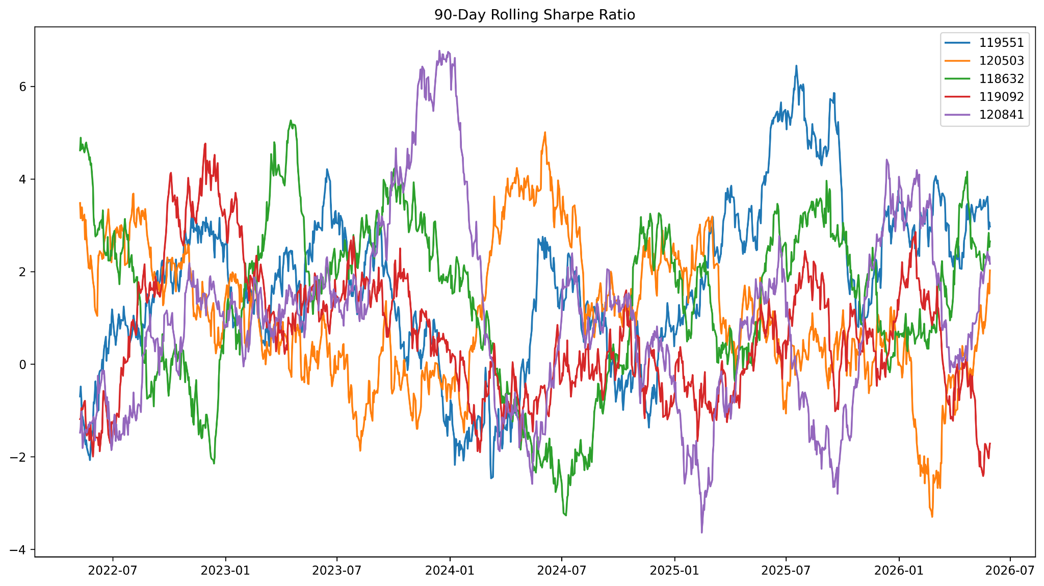
Risk & Advanced Analytics
Implemented Analytics
VaR (95%)
CVaR (95%)
Rolling Sharpe Ratio
Investor Cohort Analysis
SIP Continuity Analysis
HHI Portfolio Concentration
Key Observation
Higher-return funds generally exhibited greater downside risk and portfolio concentration.

Slide 9
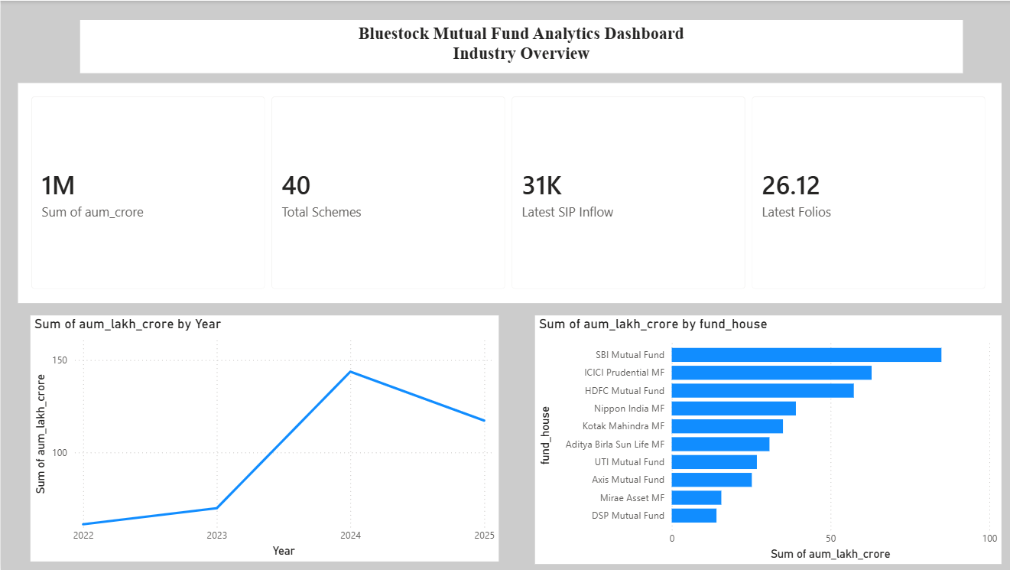
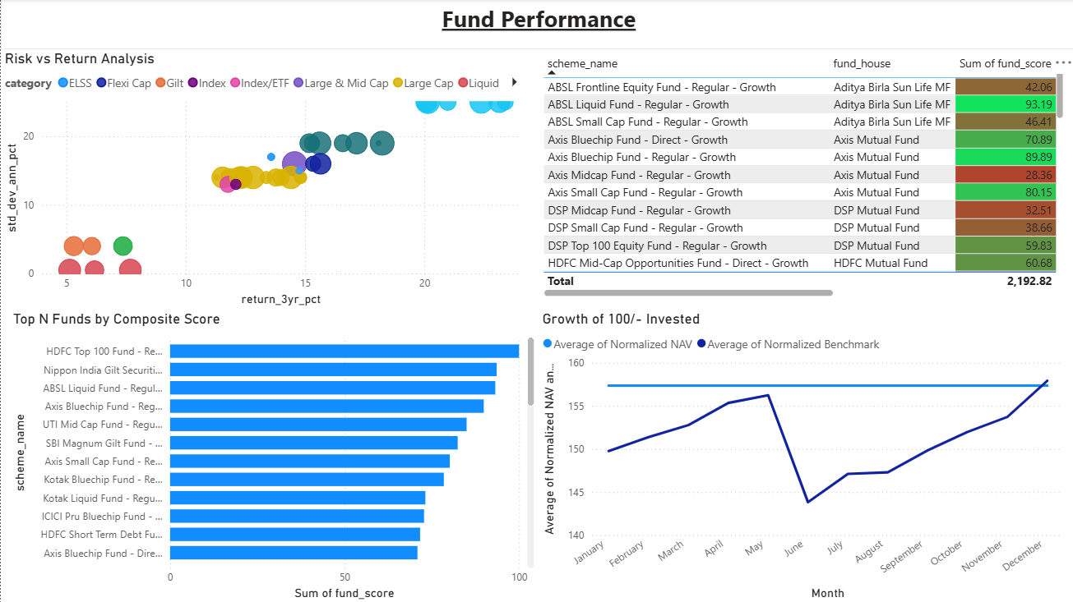
Power BI Dashboard – Industry & Performance
Dashboard Features
Dynamic Filtering
Drill Through
KPI Monitoring
Benchmark Comparison
Fund Scorecard

Slide 10
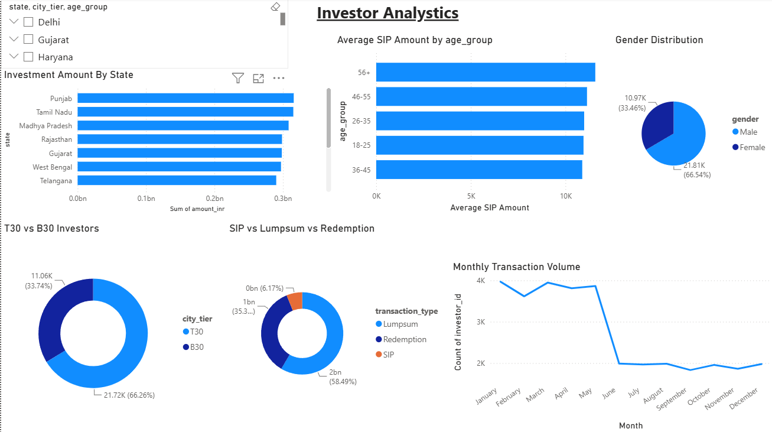
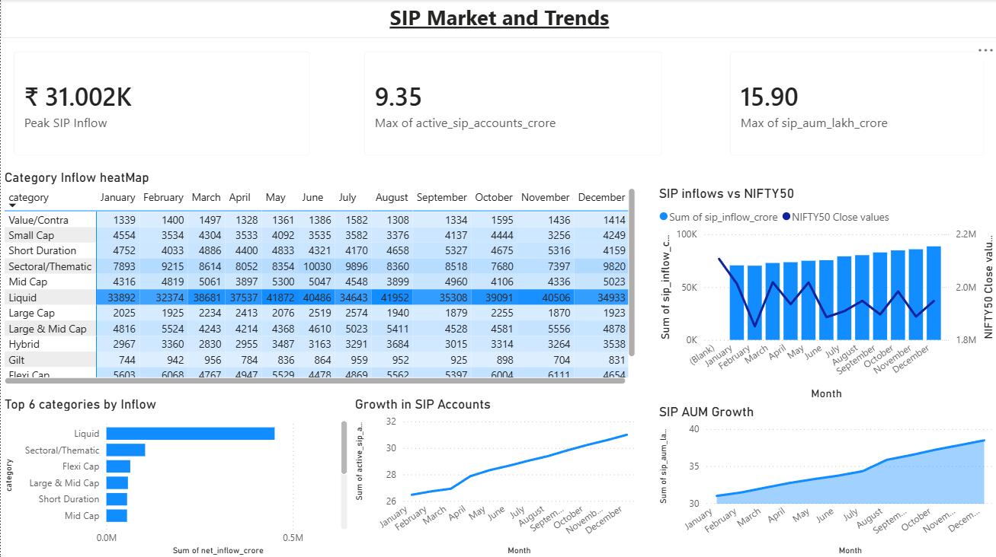
Power BI Dashboard – Investors & Market Trends
Dashboard Features
Investor Analytics
SIP Analysis
Market Trends
Category Inflows
Geographic Analysis

Slide 11
Key Findings & Recommendations
Findings
Industry AUM grew consistently across the study period.
SIP investments reached record highs.
Small-cap funds delivered higher returns but higher risk.
Risk-adjusted metrics provided better evaluation than absolute returns.
Investor participation expanded beyond metropolitan regions.
Recommendations
Focus on risk-adjusted returns
Encourage long-term SIP investing
Improve diversification
Monitor downside risk using VaR and CVaR

Slide 12
Thank You

